Slide 1


Natural Cities as an Efficient Clustering Method for Geospatial Big Data
Zheng Ren
University of Gävle, Sweden
zheng.ren@hig.se
Notes:
Title change to another one

Slide 2
Outline
The definition and history of natural cities
Difference between traditional cities and natural cities
Definition and history of natural cities
Different categories of natural cities
How to generate natural cities from massive geospatial big data?
Generate natural cities from vector and raster data using ESRI ArcGIS
Generate natural cities using Axwoman extension for your project
Generate natural cities using open source Python libraries
Comparation between natural cities and other clustering algorithms
Clustering points using k-means algorithm
Clustering points using DBSCAN algorithm
Comparation different clustering algorithm using geospatial big data

Slide 3

The definition and history
What is a city?
A city is a permanent and densely settled place for human activities primarily on non-agricultural tasks.
The boundaries of cities are administrative boundaries defined by city planners and authorities.
The relatively high density of housing, transportation and communication facilitates the interaction between people and urban environment.

Slide 4
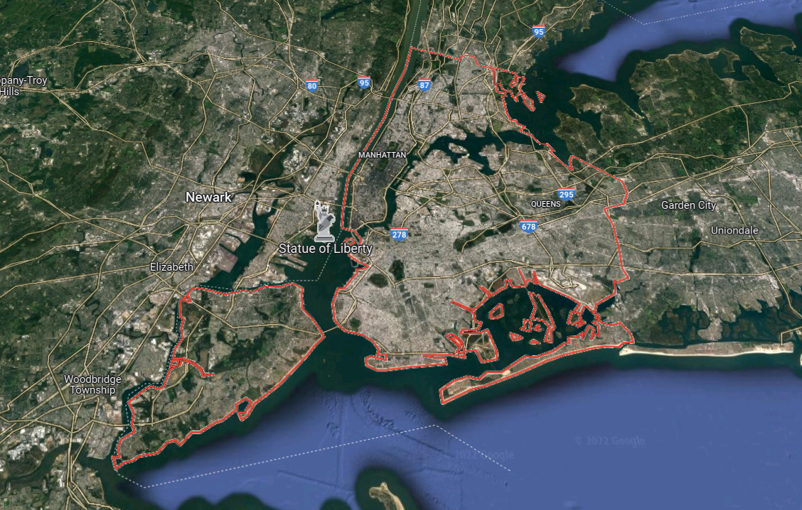
The definition and history
Traditional cities
City boundaries are defined legally and administratively by the local authorities and urban planners
Census-designated places to define the city boundaries
Population as a threshold to determine the city boundaries
Arbitrary and Subjective
Notes:
Cities defined in the traditional way are somewhat arbitrary because of their legally or administratively determined
boundaries. Not all people live in these ‘cities’. This is because some places are excluded from being census places due to state law.
According to the US 2000 census data, only 80% of the entire US population lived in the 276 metropolitan areas, whereas only 74% live in the 25,359 census places.
Population as a threshold could varies from country to country in terms of the population density. For example, a city in Sweden or Norway might not qualify as a city in China or Japan.

Slide 5
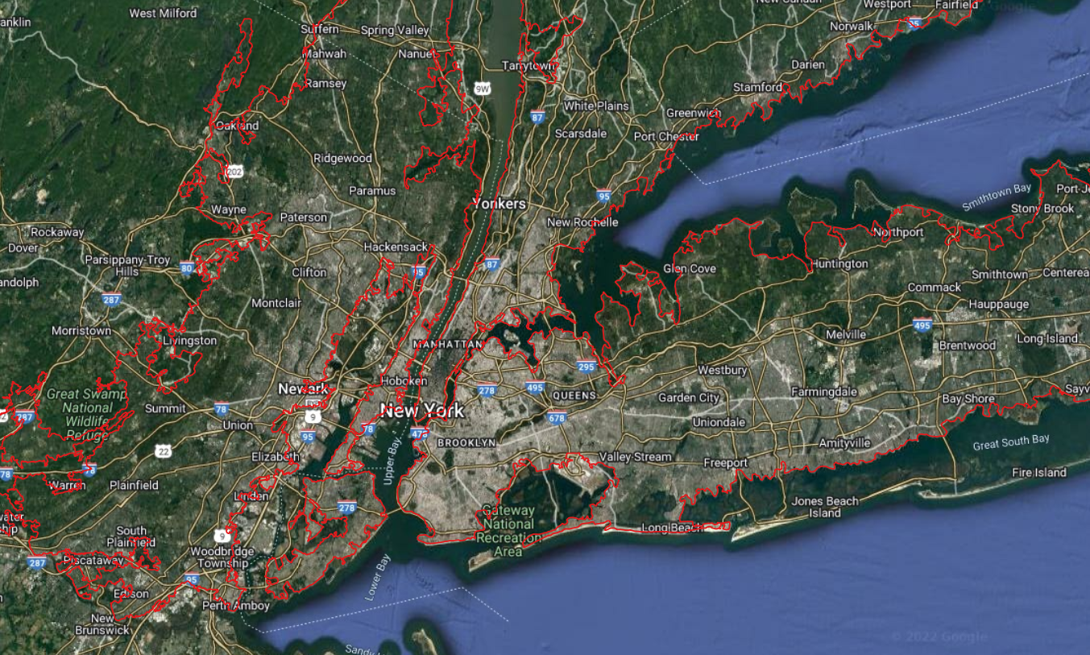
The definition and history
Natural cities
City boundaries are naturally derived from massive geographic information, such as street junctions, buildings, nighttime imagery and social media locations etc.
Head/tail division rule to determine a threshold to delineate the city boundaries. The threshold is decided by the data itself.
City boundaries are derived bottom-up instead of top-down.
Natural and Objective
Notes:
The term ‘natural cities’ refers to the human settlements or human activities in general on Earth's surface that are naturally or objectively defined and delineated from massive geographic information based on head/tail division rule, a non-recursive form of head/tail breaks.
Such geographic information could be from various sources, such as massive street junctions and street ends, a massive number of street blocks, nighttime imagery and social media users’ locations etc.
Distinctive from conventional cities, the adjective ‘natural’ could be explained not only by the sources of natural cities, but also by the approach to derive them. It is delineated from massive geographic information based on head/tail division rule, a non-recursive form of head/tail breaks.
One of the main advantages of natural cities is that it is derived bottom-up instead of top-down. That means that the borders are determined by the data of something physical rather than determined by an administrative government or administration.

Slide 6
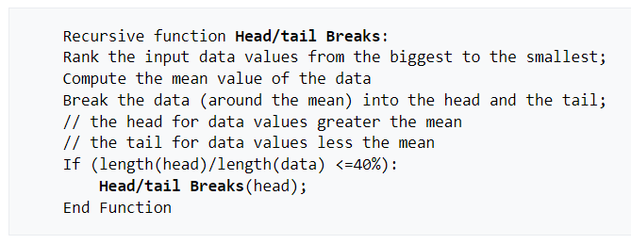
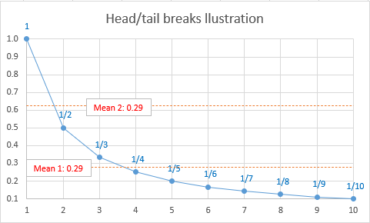
The definition and history
Head/tail breaks
Head/tail breaks is a clustering algorithm scheme for data with a heavy-tailed distribution such as power laws and lognormal distributions.
Head/tail breaks - Wikipedia
References:
Jiang B. and Liu X. (2012), Scaling of geographic space from the perspective of city and field blocks and using volunteered geographic information, International Journal of Geographical Information Science, 26(2), 215-229.
Jiang B. (2013), Head/tail breaks: A new classification scheme for data with a heavy-tailed distribution, The Professional Geographer, 65(3), 482 – 494.
Jiang B. and Yin J. (2014), Ht-index for quantifying the fractal or scaling structure of geographic features, Annals of the Association of American Geographers, 104(3), 530–541.
Notes:
Given some variable X that demonstrates a heavy-tailed distribution, there are far more small x than large ones. Take the average of all xi, and obtain the first mean m1. Then calculate the second mean for those xi greater than m1, and obtain m2. In the same recursive way, we can get m3 depending on whether the ending condition of no longer far more small x than large ones is met. For simplicity, we assume there are three means, m1, m2, and m3. This classification leads to four classes: [minimum, m1], (m1, m2], (m2, m3], (m3, maximum].
The resulting number of classes is referred to as ht-index, an alternative index to fractal dimension for characterizing complexity of fractals or geographic features: the higher the ht-index, the more complex the fractals.

Slide 7
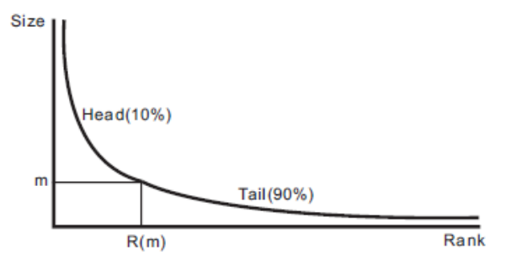
The definition and history
Head/tail division rule
“Given a variable X, if its values x follow a heavy tailed distribution, then the mean (m) of the values can divide all the values into two parts: a high percentage in the tail, and a low percentage in the head.” (Jiang and Liu, 2012)
References:
Jiang B. and Liu X. (2012), Scaling of geographic space from the perspective of city and field blocks and using volunteered geographic information, International Journal of Geographical Information Science, 26(2), 215-229.
Jiang B. (2013), Head/tail breaks: A new classification scheme for data with a heavy-tailed distribution, The Professional Geographer, 65(3), 482 – 494.
Jiang B. and Yin J. (2014), Ht-index for quantifying the fractal or scaling structure of geographic
features, Annals of the Association of American Geographers, 104(3), 530–541.
Notes:
A rank-size distribution with the x-axis as the ranking and the y-axis as the corresponding ranked data values. The arithmetic mean is m and the corresponding ranking is R(m). The head and the tail contain imbalanced amounts of data values. Take 10 numbers as an example, the first head contains 3 numbers, while the tail contains 7 numbers.

Slide 8
The definition and history
Jiang and Liu 2010, Natural cities from street blocks using head/tail division rule.
Jia and Jiang 2011, Measuring urban sprawl using natural cities from street nodes.
Jiang and Yin 2014, Ht-index for quantifying the scaling structure of geographic features.
Jiang and Miao 2015, Generating natural cities by constructing TIN method from social media data.
Jiang 2019, natural cities from all building locations in America.
2010
2012
2014
2015
2019
Jiang and Jia 2011, Natural cities from street nodes using clustering algorithm.
Jiang 2013, Head/tail breaks for heavy tailed distribution data.
Jiang, Yin and Liu 2014, Generate world natural cities from nighttime imagery.
Long 2016, Redefine Chinese cities using street junctions and head/tail breaks.

Slide 9
The definition and history
Natural cities families
Vector data
Natural cities
NC from street nodes,
NC from social media data,
NC from building locations etc.
TIN method
NC from street nodes,
NC from street blocks
Aggregation method
NC from nighttime imagery
Raster data

Slide 10
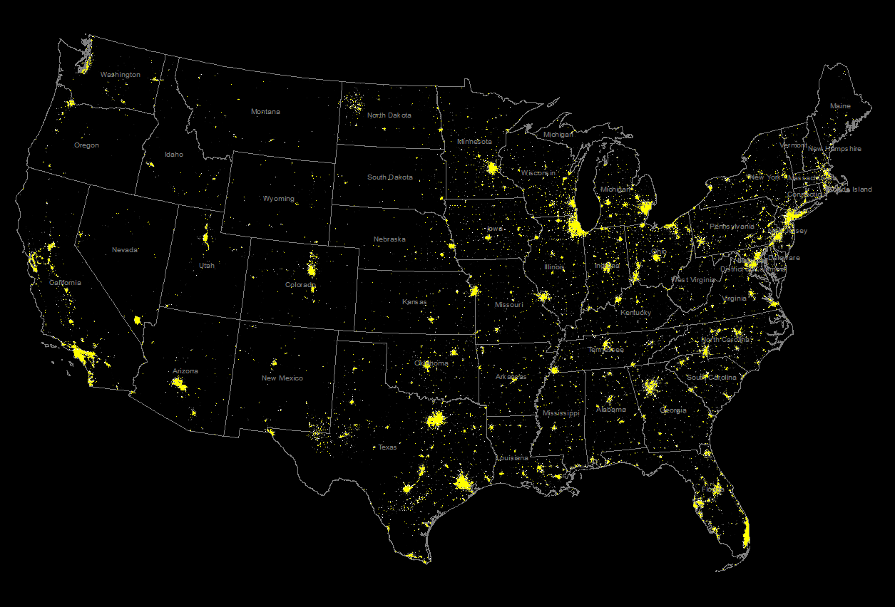
The definition and history
Natural cities of American nighttime imagery

Slide 11
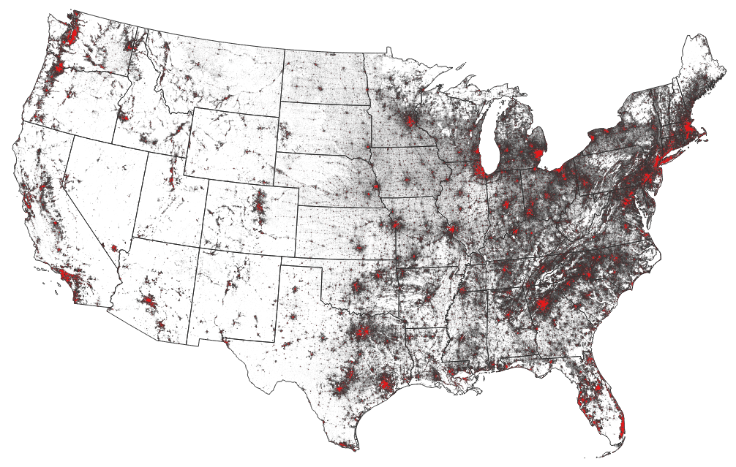
The definition and history
Natural cities of American building locations

Slide 12
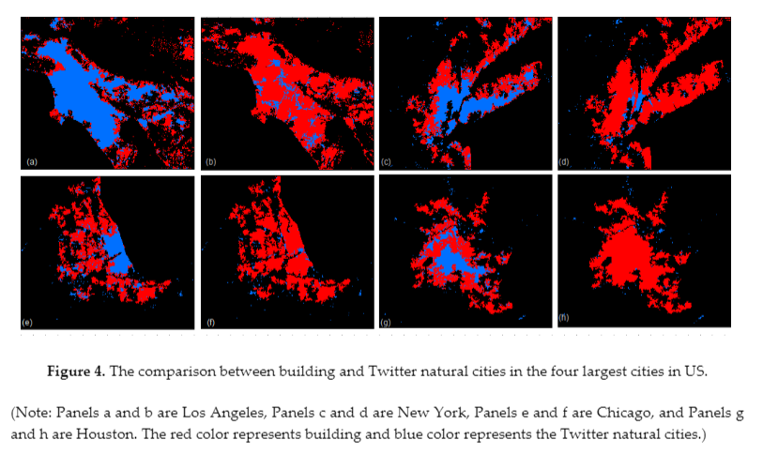
The definition and history
Natural cities of building and tweets locations in America

Slide 13
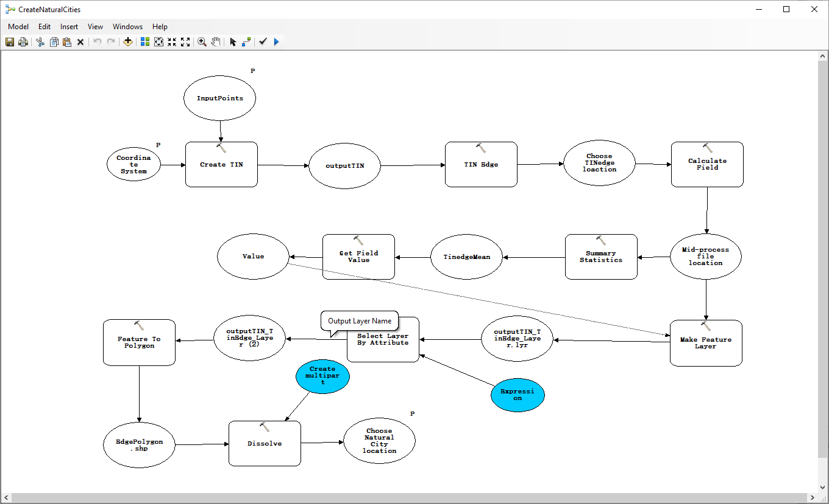
Tutorials for generating natural cities
1. Generate natural cities from massive points in ArcGIS
Based on Jiang and Miao 2015, the generation process of natural cities can be serialized in the model builder in ArcGIS.
A natural cities model can be downloaded here: NaturalCitiesModel

Slide 14
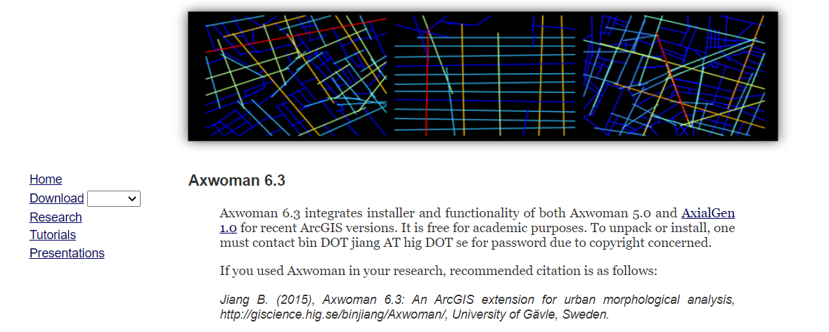
Tutorials for generating natural cities
2. Generate natural cities from massive points using Axwoman extension.
Based on Jiang and Miao 2015, the generation process of natural cities can be fastened using Axwoman extension Add-in.
The Axwoman extension for ArcGIS can be downloaded here: Axwoman Homepage (hig.se)
An add-in extension for Axwoman can be downloaded here: ZhengRen91/NC_Gen (github.com)

Slide 15
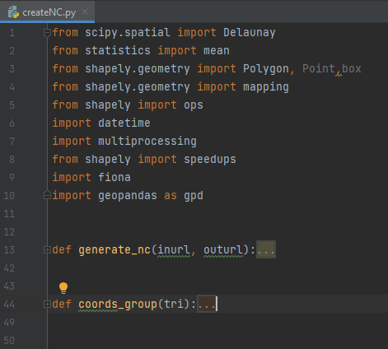
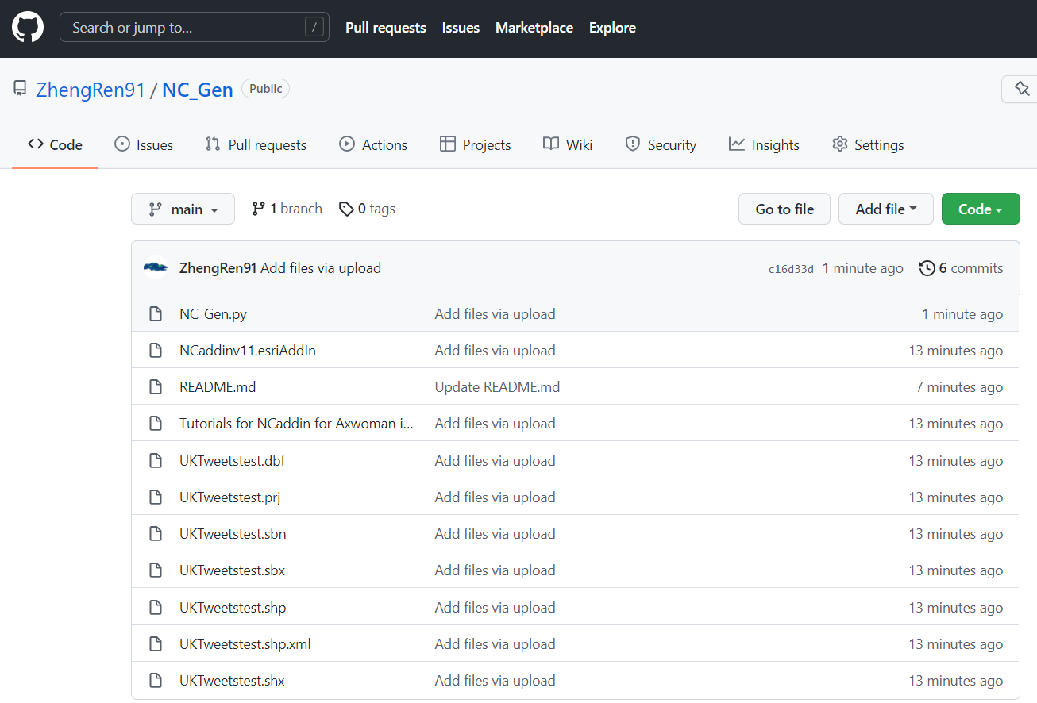
Tutorials for generating natural cities
3. Generate natural cities from massive points using Python libraries
Based on Jiang and Miao 2015, the generation process of natural cities can be customized for big data using Python libraries. An Python script for natural cities can be downloaded here: ZhengRen91/NC_Gen (github.com)

Slide 16

Comparation of other clustering methods
1. K-means clustering
K-means clustering is a method that aims to partition n observations into k clusters in which each observation belongs to the cluster with the nearest mean (cluster centers or cluster centroid), serving as a prototype of the cluster.
K-means clustering minimizes within-cluster variances and maximizes the variances between each cluster.
For the algorithm, the number of clusters must be defined before processing the data.

Slide 17
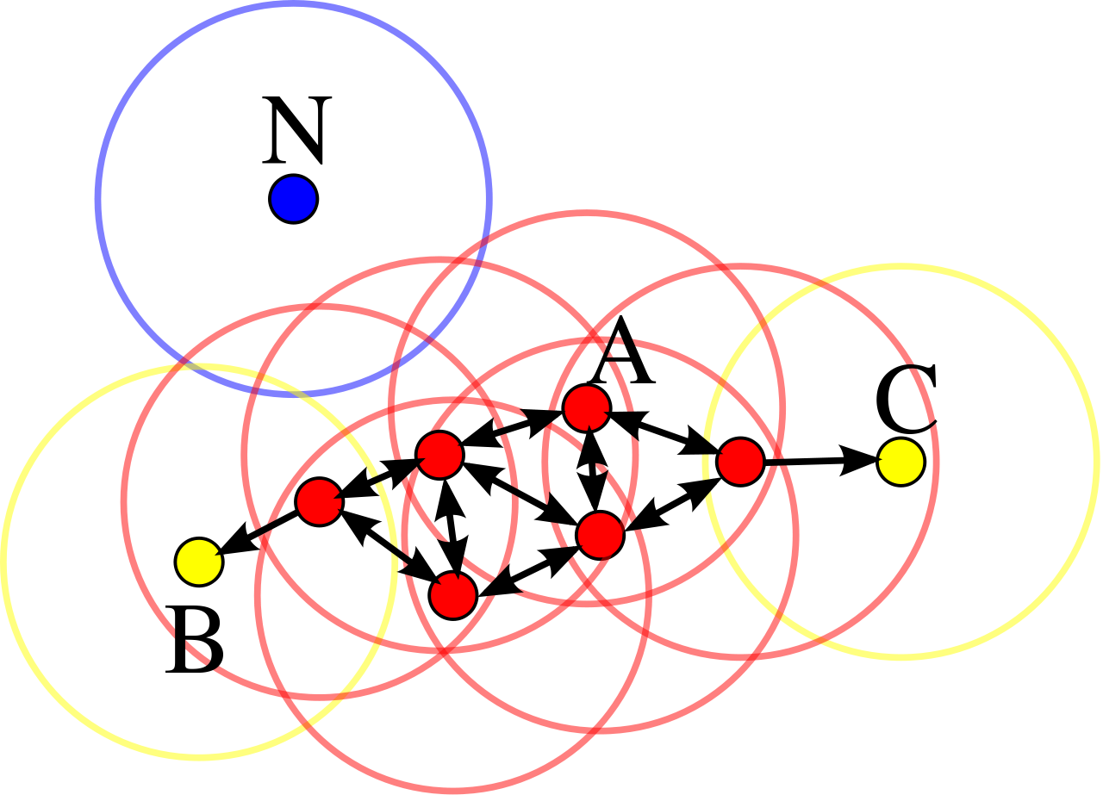
Comparation of other clustering methods
2. DBSCAN clustering
Density-based spatial clustering of applications with noise (DBSCAN) is a data clustering algorithm proposed by Martin Ester, Hans-Peter Kriegel, Jörg Sander and Xiaowei Xu in 1996.
It is a density-based clustering non-parametric algorithm: given a set of points in some space, it groups together points that are closely packed together (points with many nearby neighbors), marking as outliers points that lie alone in low-density regions (whose nearest neighbors are too far away).
DBSCAN is one of the most common clustering algorithms and also most cited in scientific literature.
In this diagram, minPts = 4. Point A and the other red points are core points, because the area surrounding these points in an ε radius contain at least 4 points (including the point itself). Because they are all reachable from one another, they form a single cluster. Points B and C are not core points, but are reachable from A (via other core points) and thus belong to the cluster as well. Point N is a noise point that is neither a core point nor directly-reachable.

Slide 18
Comparation of other clustering methods
3. Compare NC clustering with K-means, DBSCAN clustering algorithm
K-means clustering and DBSCAN need to define the parameters such as K, minPts, ε.
K-means clustering is time-consuming compared to the other ones.
The algorithm does not guarantee convergence to the global optimum.
The cutoff value of NC clustering is decided by head/tail breaks.
NC clustering and DBSCAN are not required to specify the number of clusters.
NC clustering considers the whole data configuration to deicide the clusters.
NC clustering is faster than the other ones.

Slide 19
Comparation of other clustering methods
3. Compare NC clustering with K-means, DBSCAN clustering algorithm
Clustering algorithms | Speed | Parameters | Accuracy
K-means clustering | Slow | 1 parameter | Not guaranteed
DBSCAN clustering | Fast | 2 parameters | Noises are allowed
Natural cities clustering | Fast | No need | Naturally decided

Slide 20
Thank you!
Notes:
Title change to another one

